Slide 1
Free RTOS Part II

Slide 2
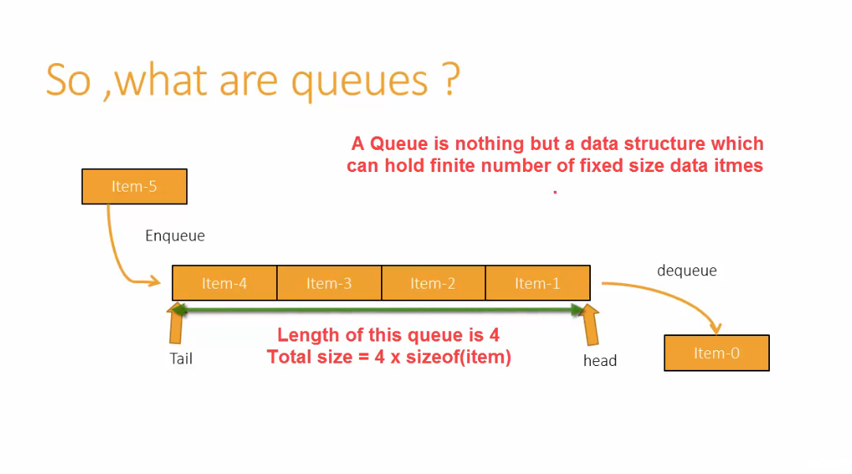

Slide 3
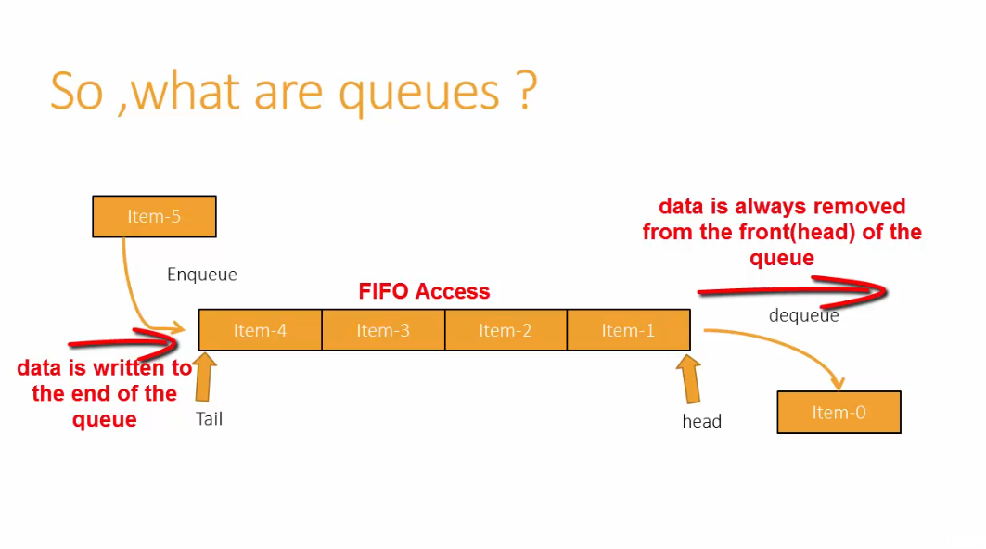

Slide 4
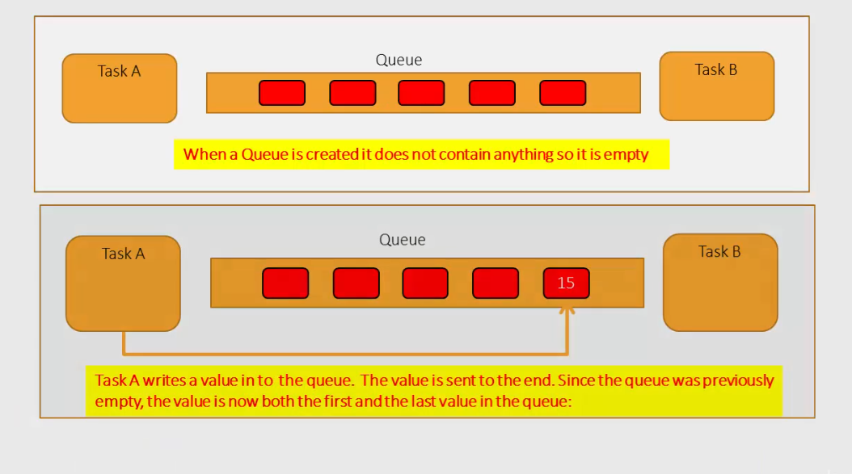

Slide 5
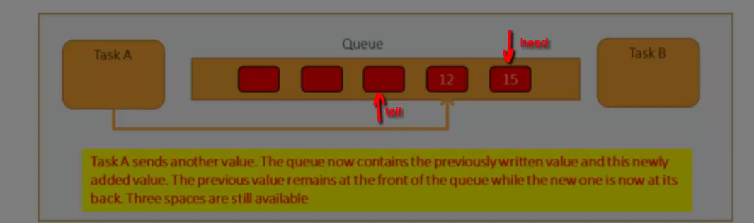
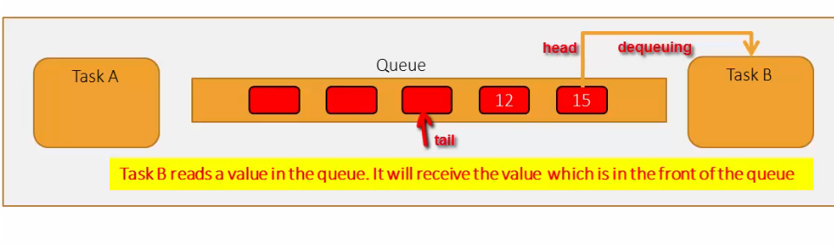

Slide 6
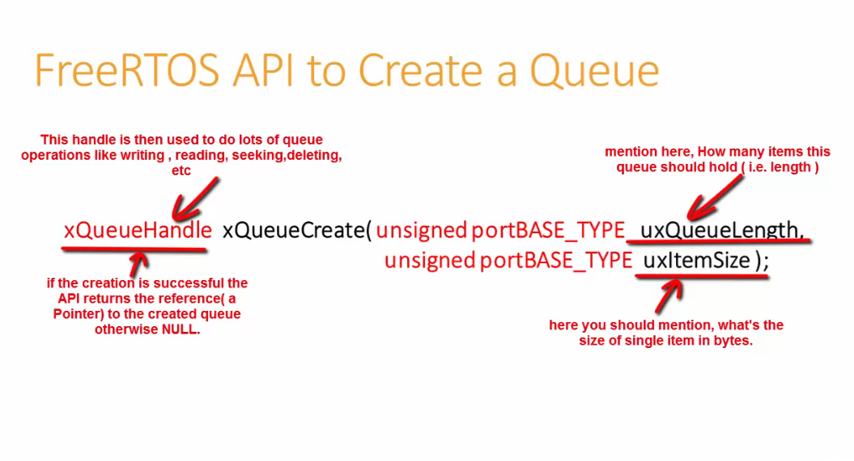

Slide 7
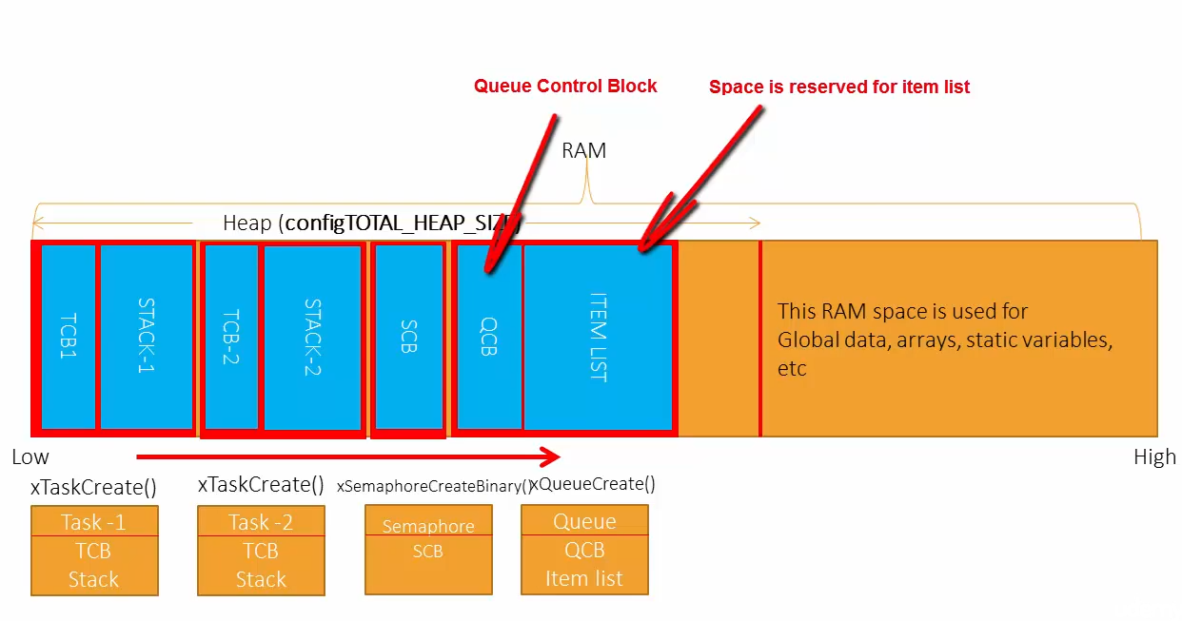

Slide 8
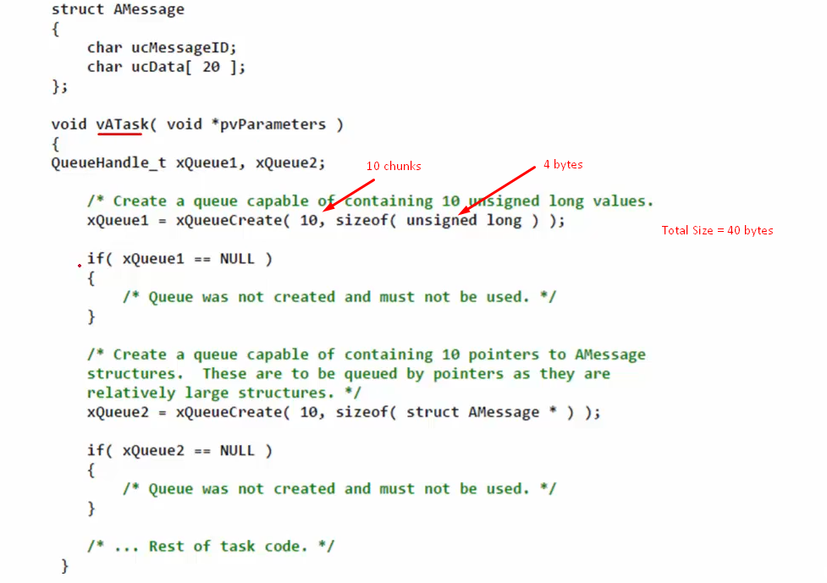
xQueue1 က QCB နဲ့ ITEM LISTS များကို pointer အနေနဲ့ လှမ်းသုံး။
memory မလုံလောက်ပါက NULL return ပြန်မှာပါ။

Slide 9
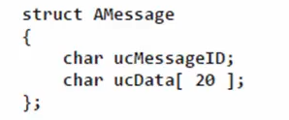
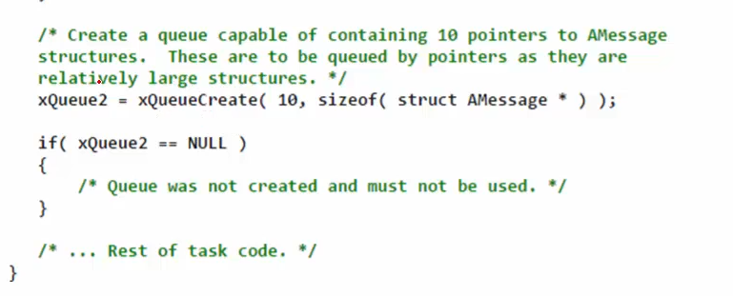
Here, this queue will hold 10 different struct pointers instead of struct itself.
QCB အတွက်လည်း heap ထဲက size အနဲငယ်ယူသုံးသေးတာကိုသတိပြုရန်
AMessage Structure အသုံးပြုပီး Queue တစ်ခုဆောက်မှာပါ။
ပုံမှန် Structure တစ်ခုလုံးရဲ့ size က 21 bytes ဖြစ်မယ်။ Queue ဆောက်ထားတာက 10 chunks ဆိုရင် = 210 bytes ဖြစ်ပါတယ်။
Space ကများလွန်းတဲ့အတွက်၊ Amessage Structure ကို pointer အနေနဲ့ ပြန်သုံးလိုက်ခြင်းဖြစ် Struct ရဲ့ size က 4 bytes နဲ့ 10 chunks ဆိုရင် 40 bytes ပဲပြန်ရမှာပါ။

Slide 10
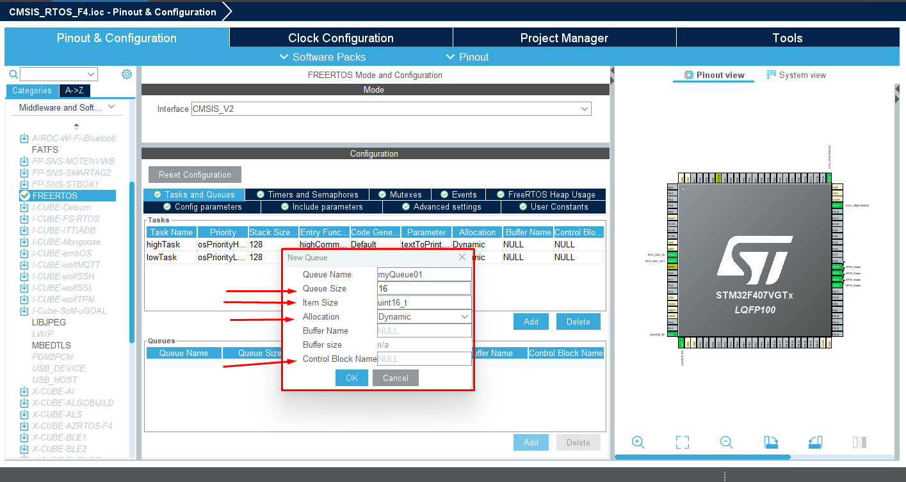

Slide 11
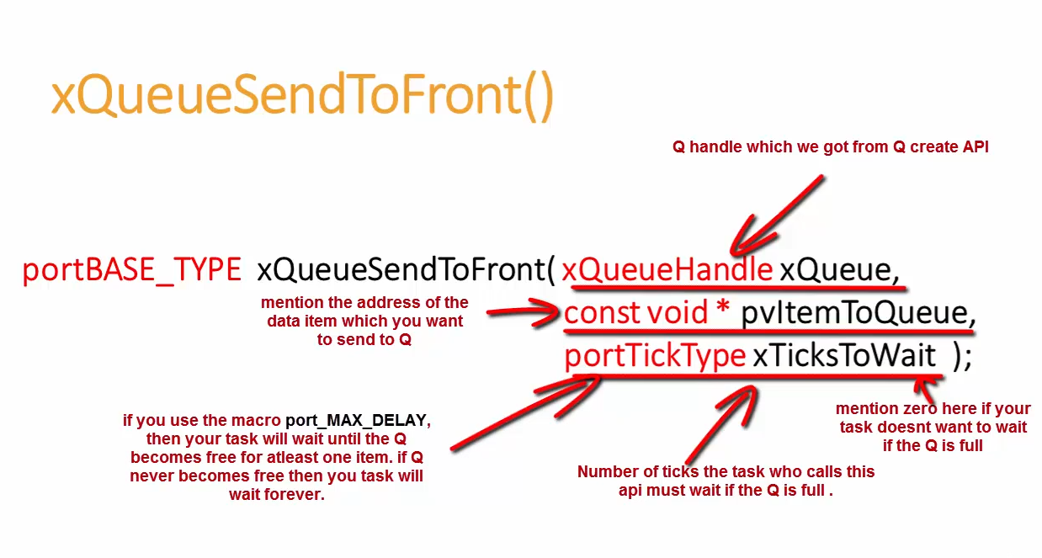

Slide 12
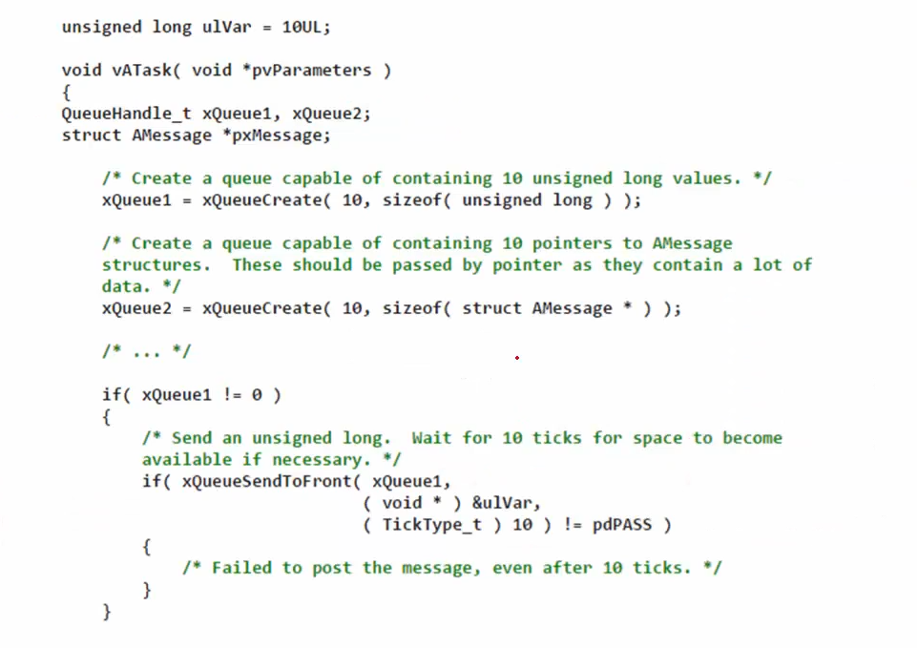

Slide 13
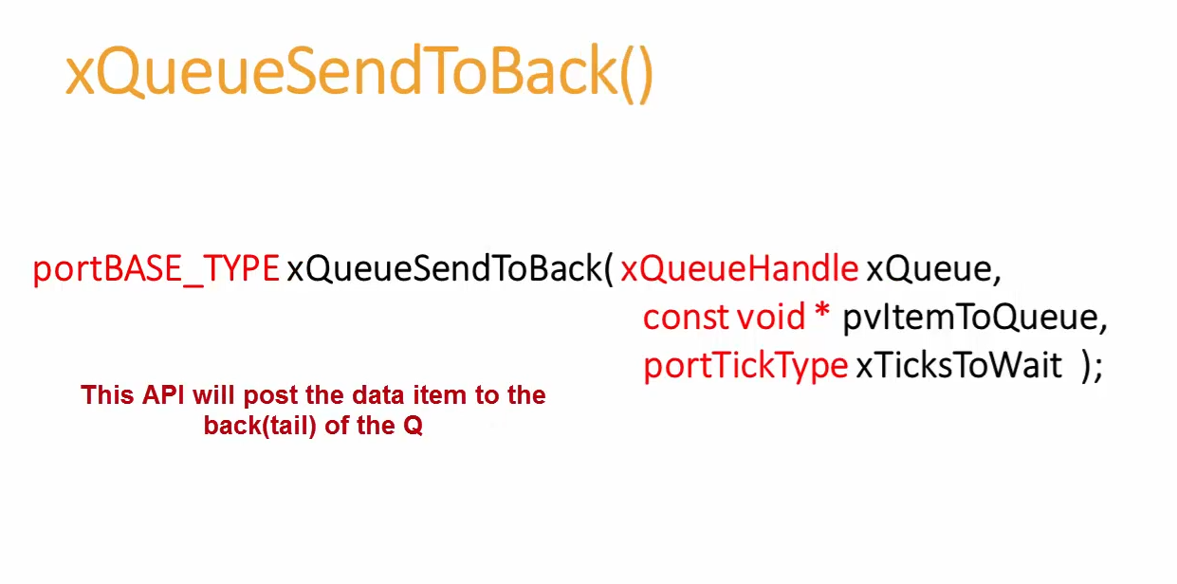

Slide 14
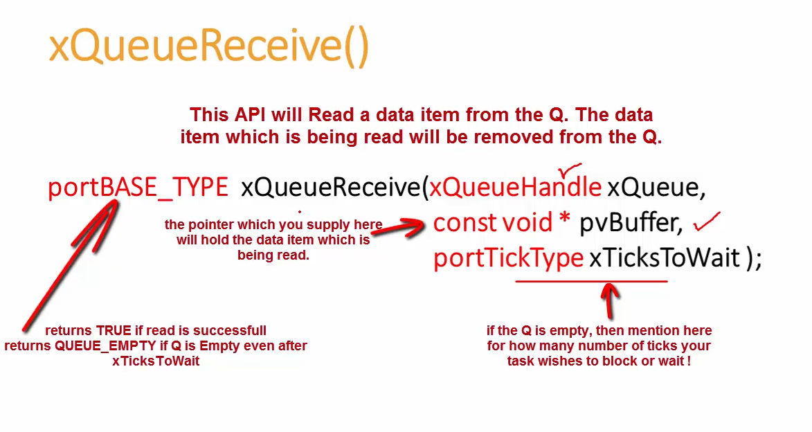

Slide 15
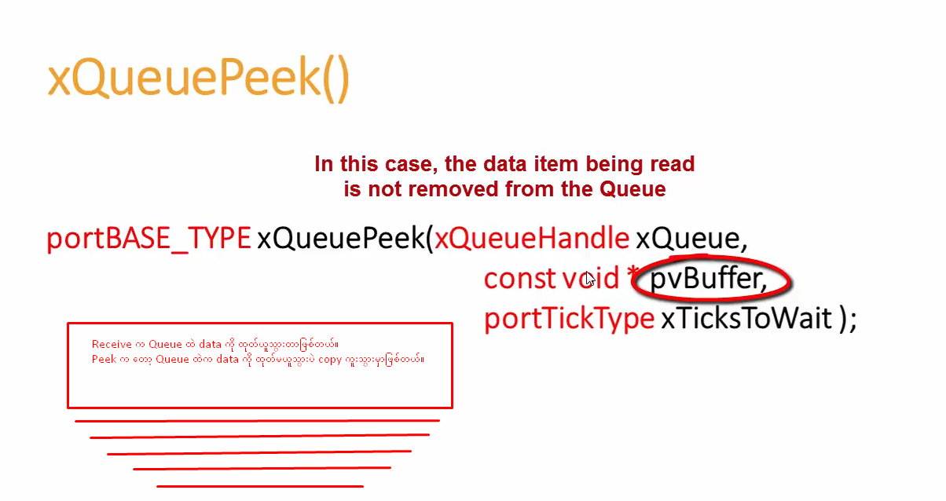

Slide 16
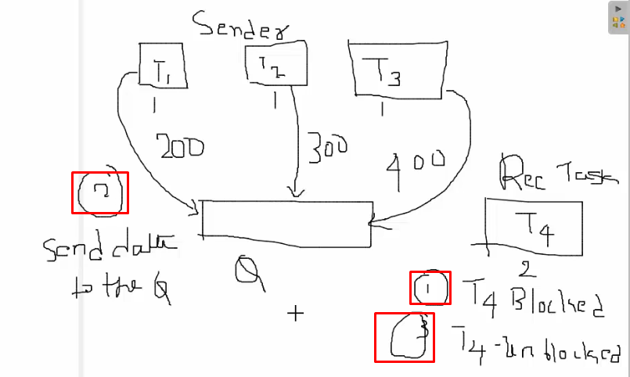

Slide 17
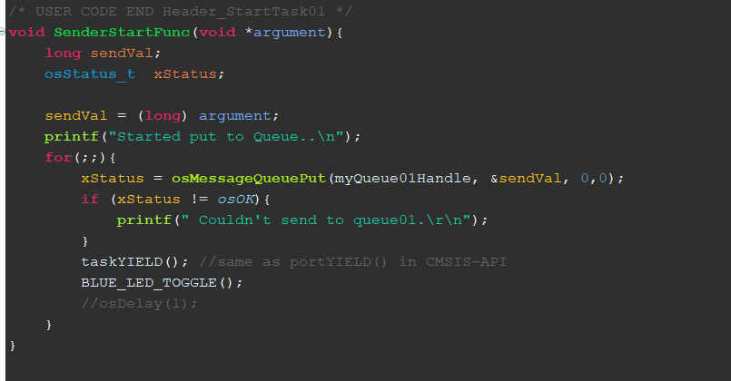
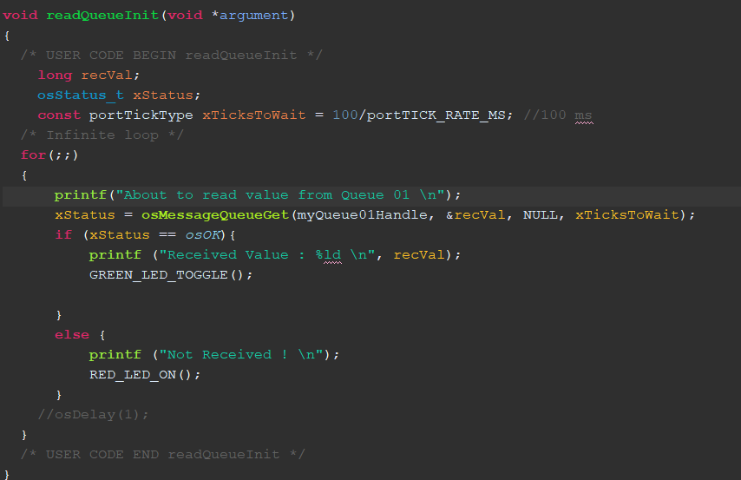
osMessageQueuePut()
osMessageQueueGet()

Slide 18
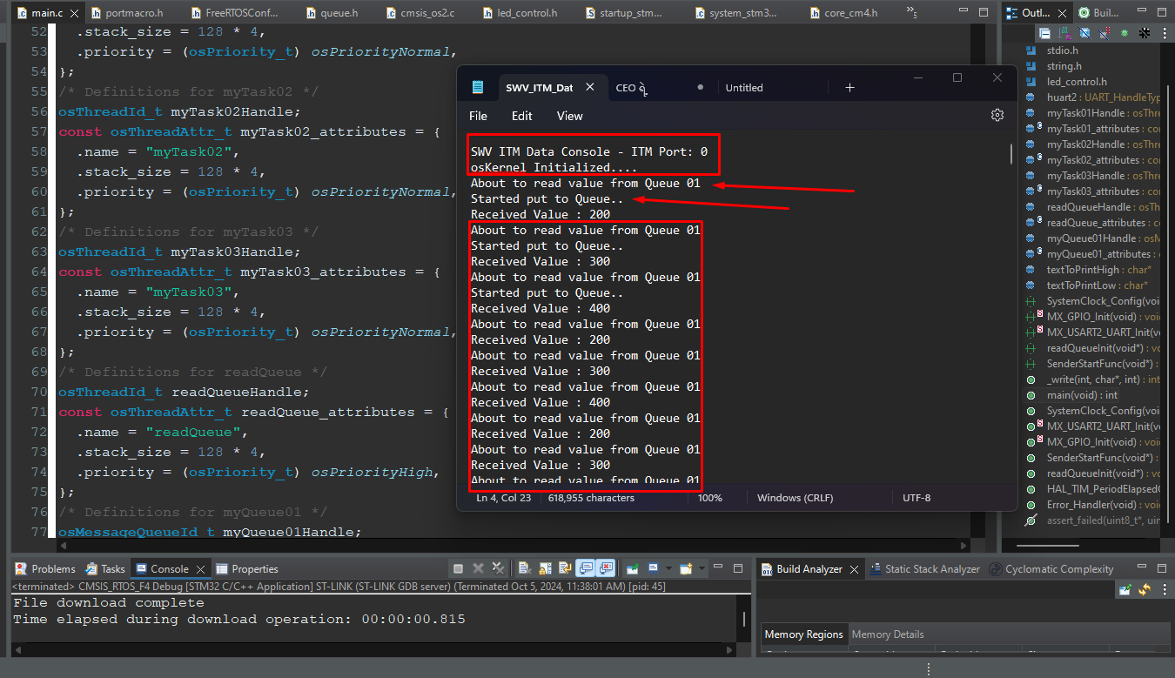

Slide 19
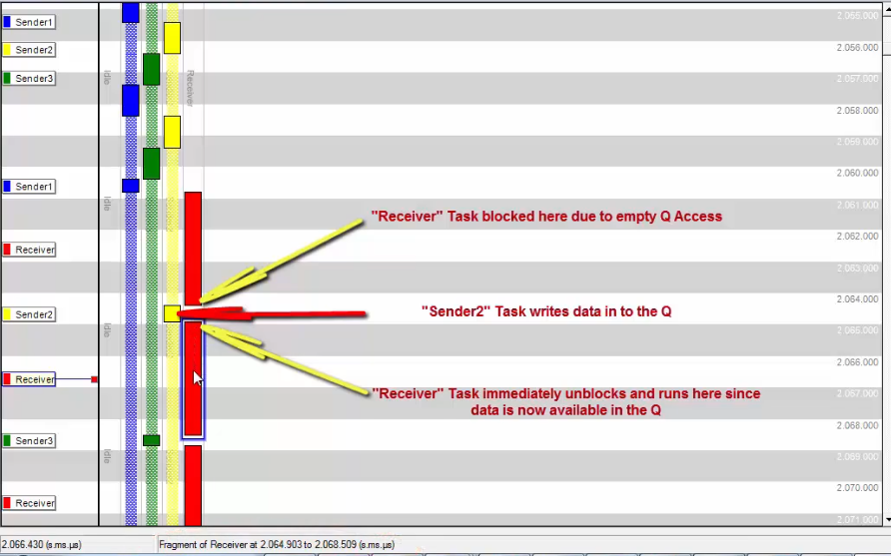

Slide 20
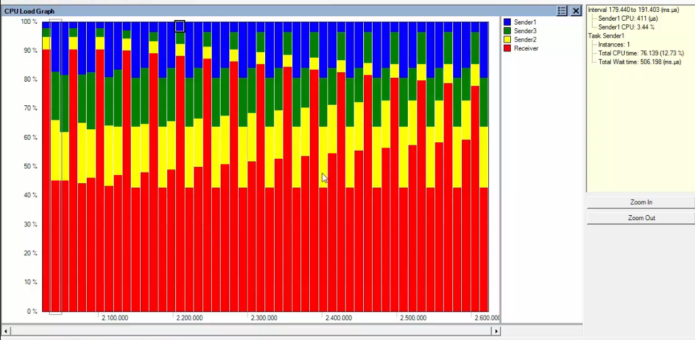

Slide 21
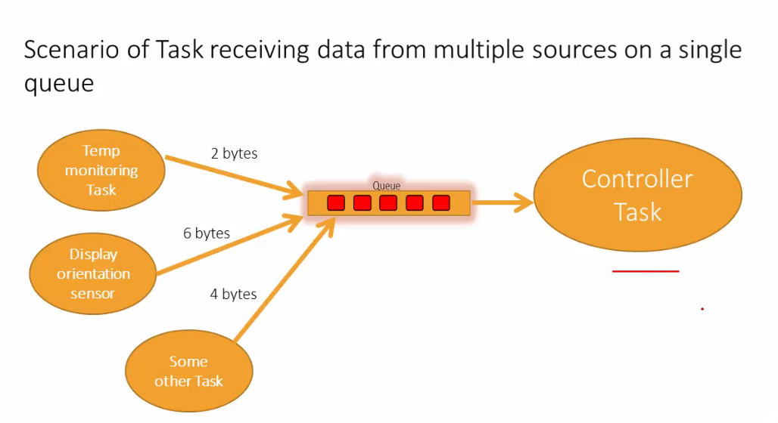
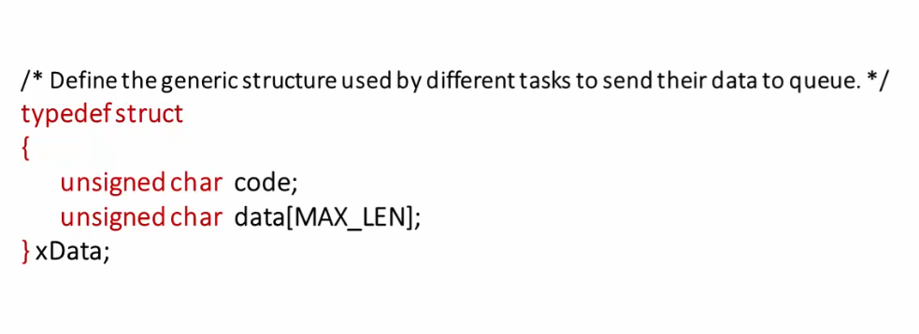

Slide 22
Structure နှင့် Pointer သုံးပြီး စမ်းသပ်ရန် ကျန်ရှိ

Slide 23
Synchronization in Computing

Slide 24
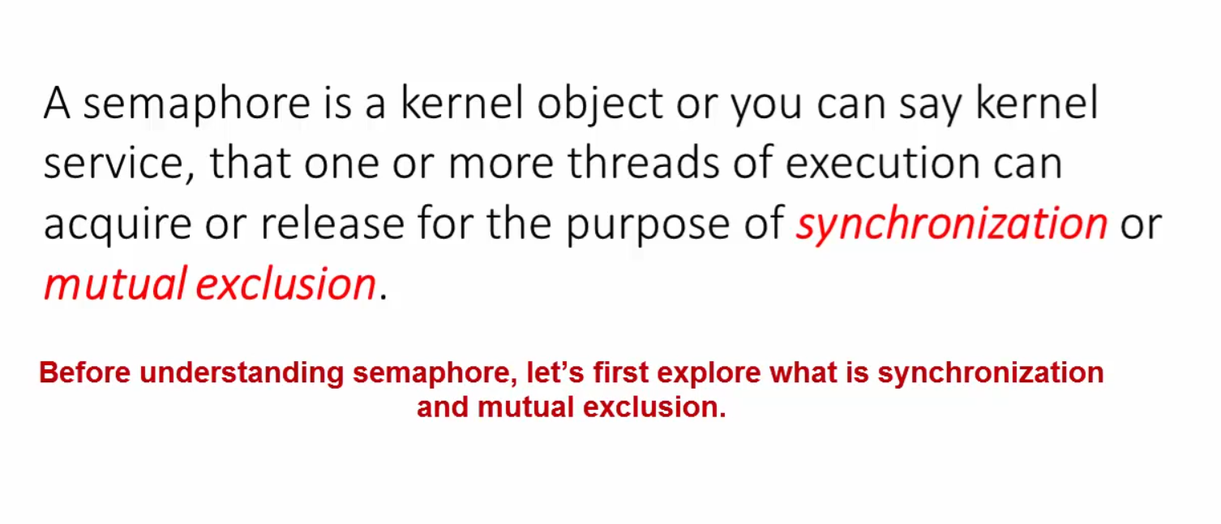

Slide 25
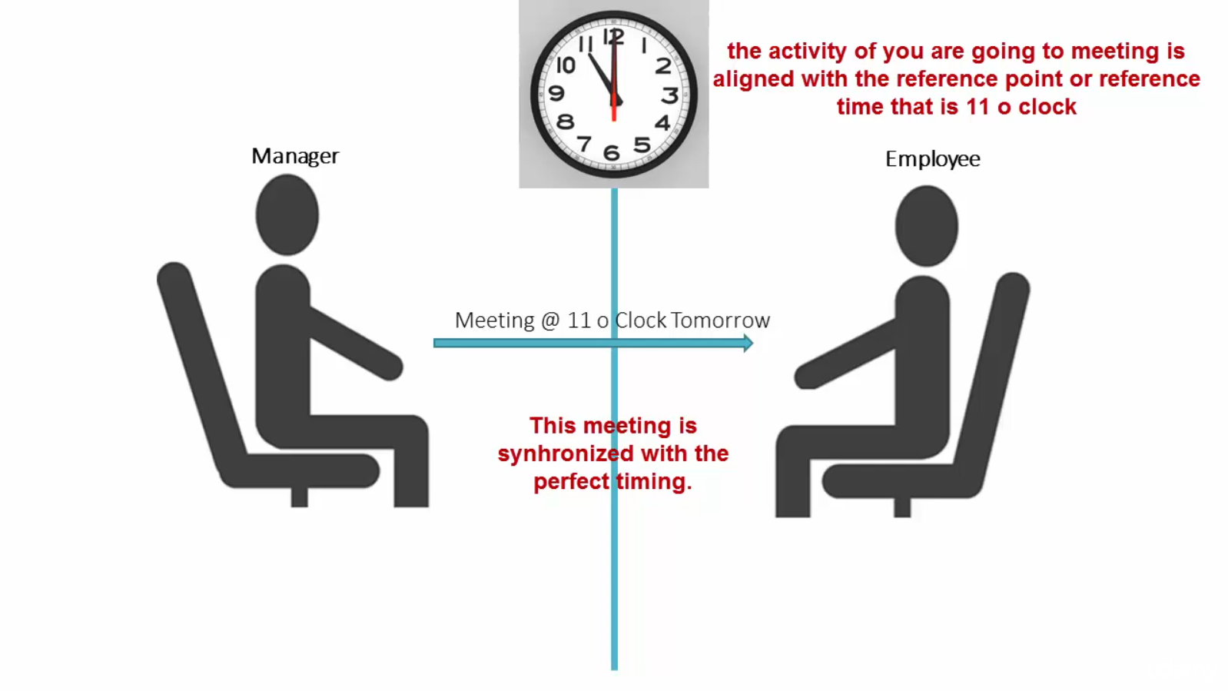

Slide 26
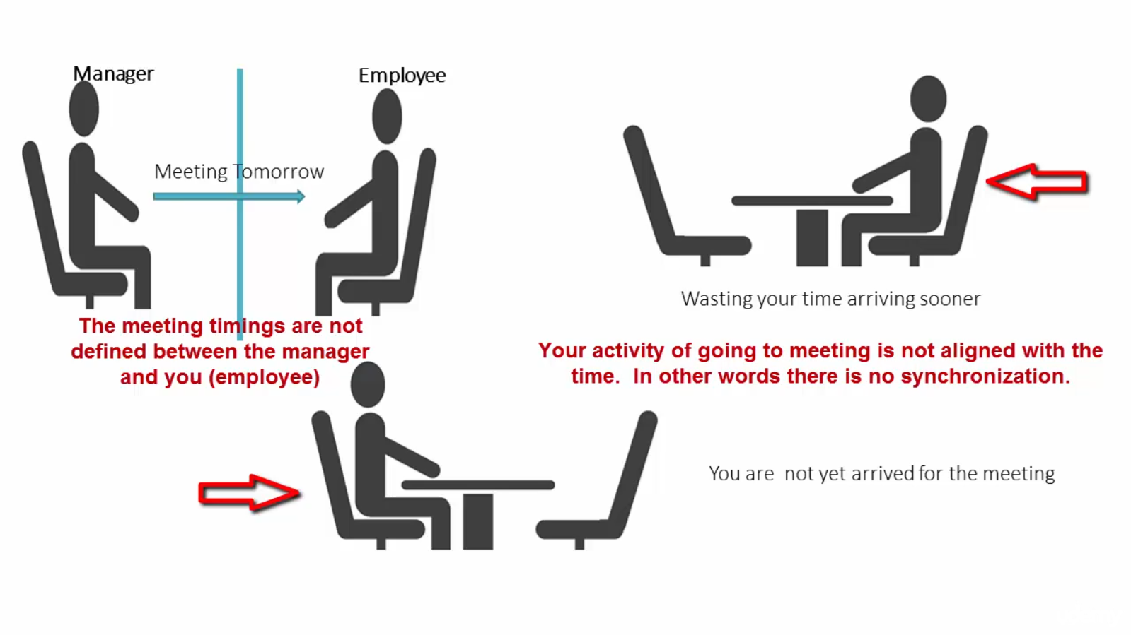

Slide 27
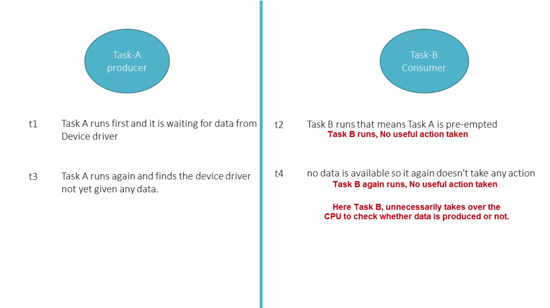

Slide 28
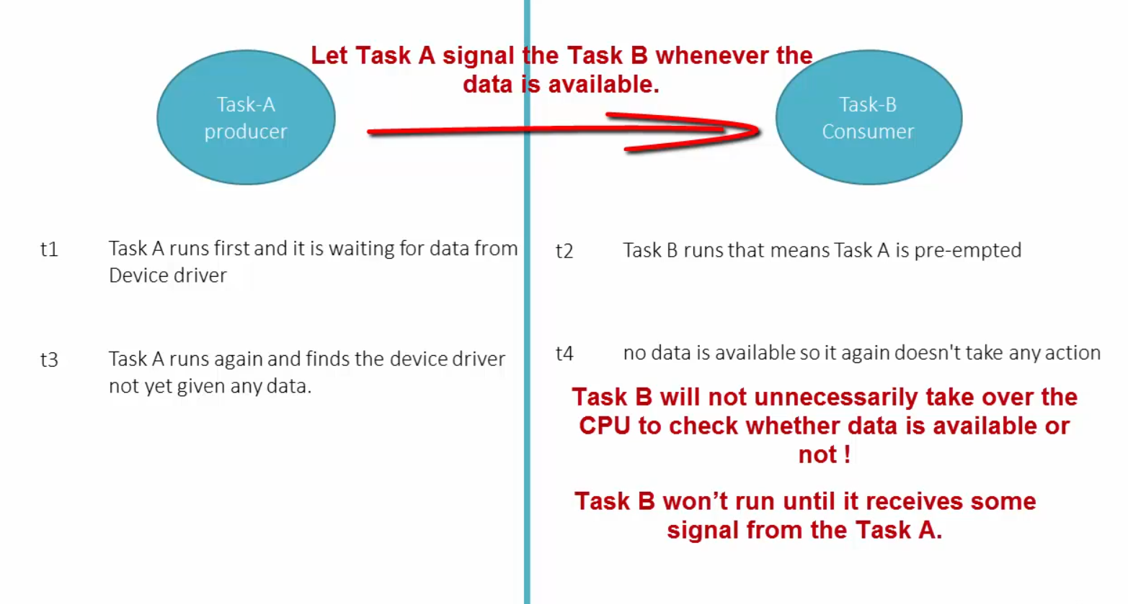

Slide 29
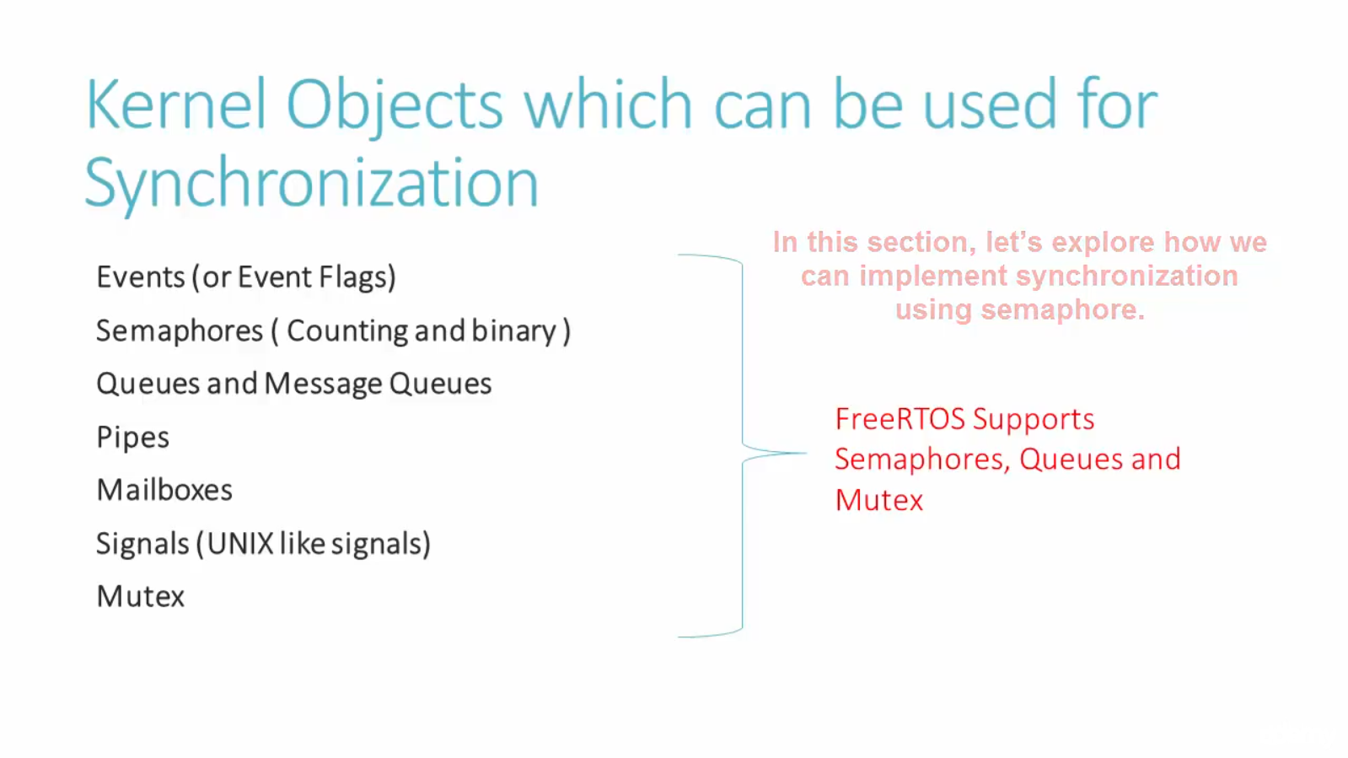

Slide 30
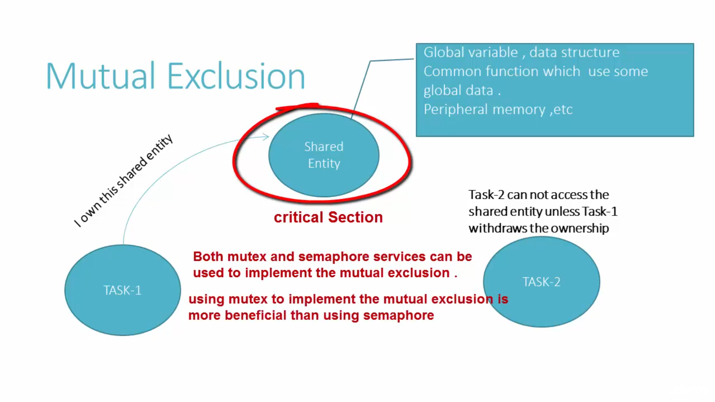

Slide 31
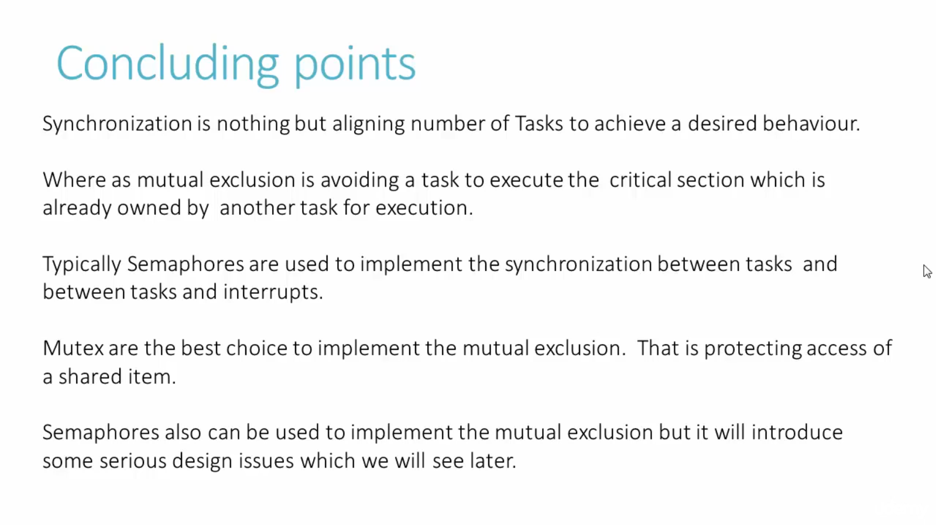

Slide 32
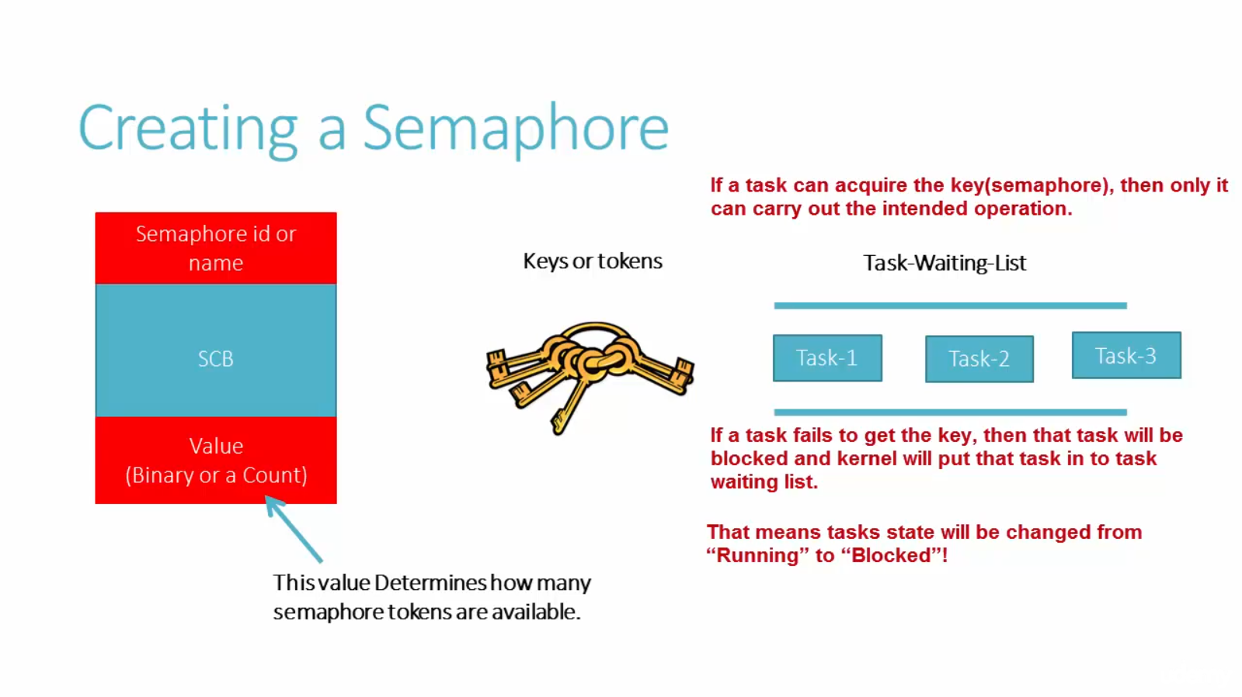

Slide 33
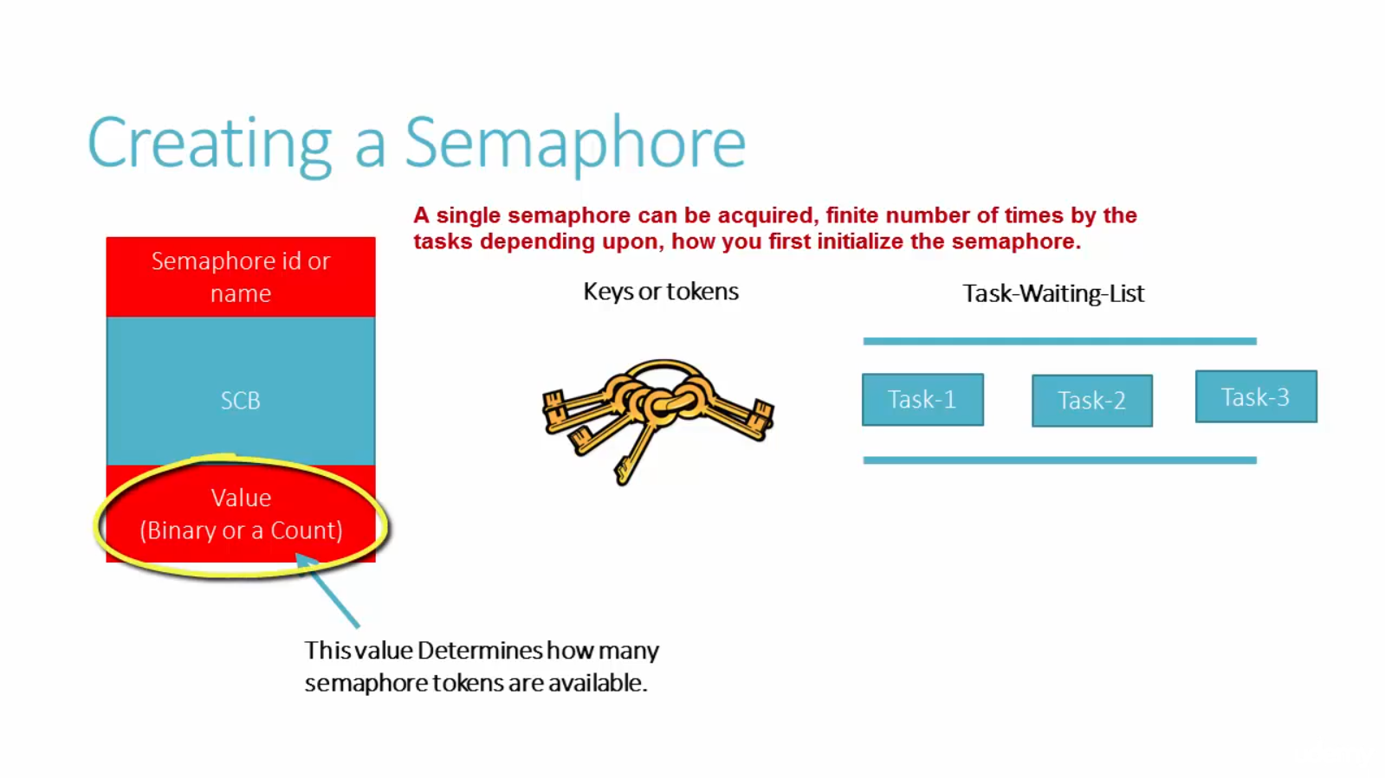

Slide 34
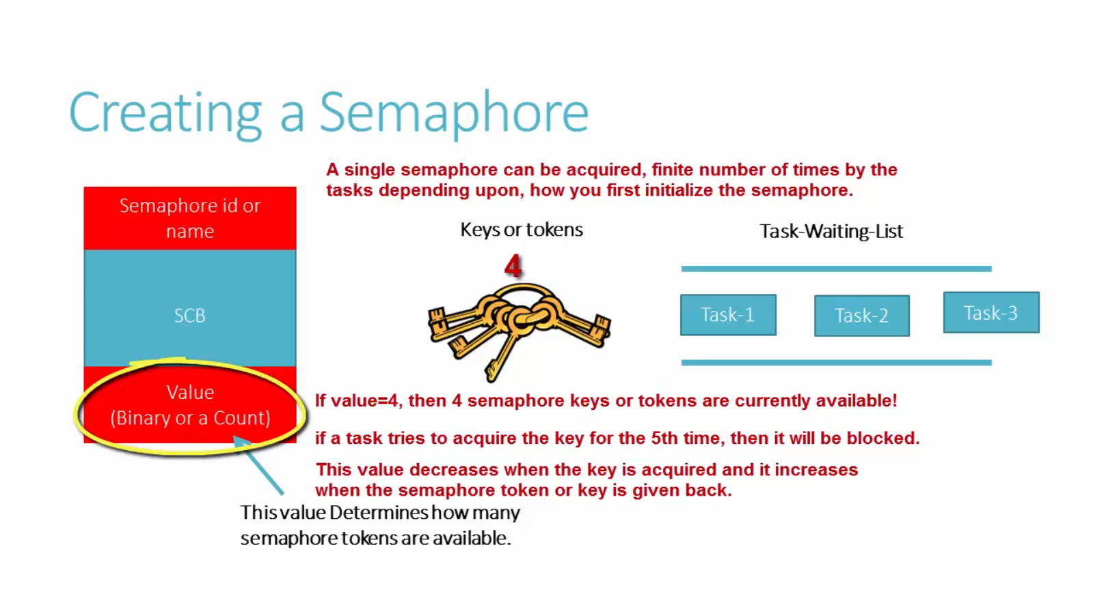

Slide 35
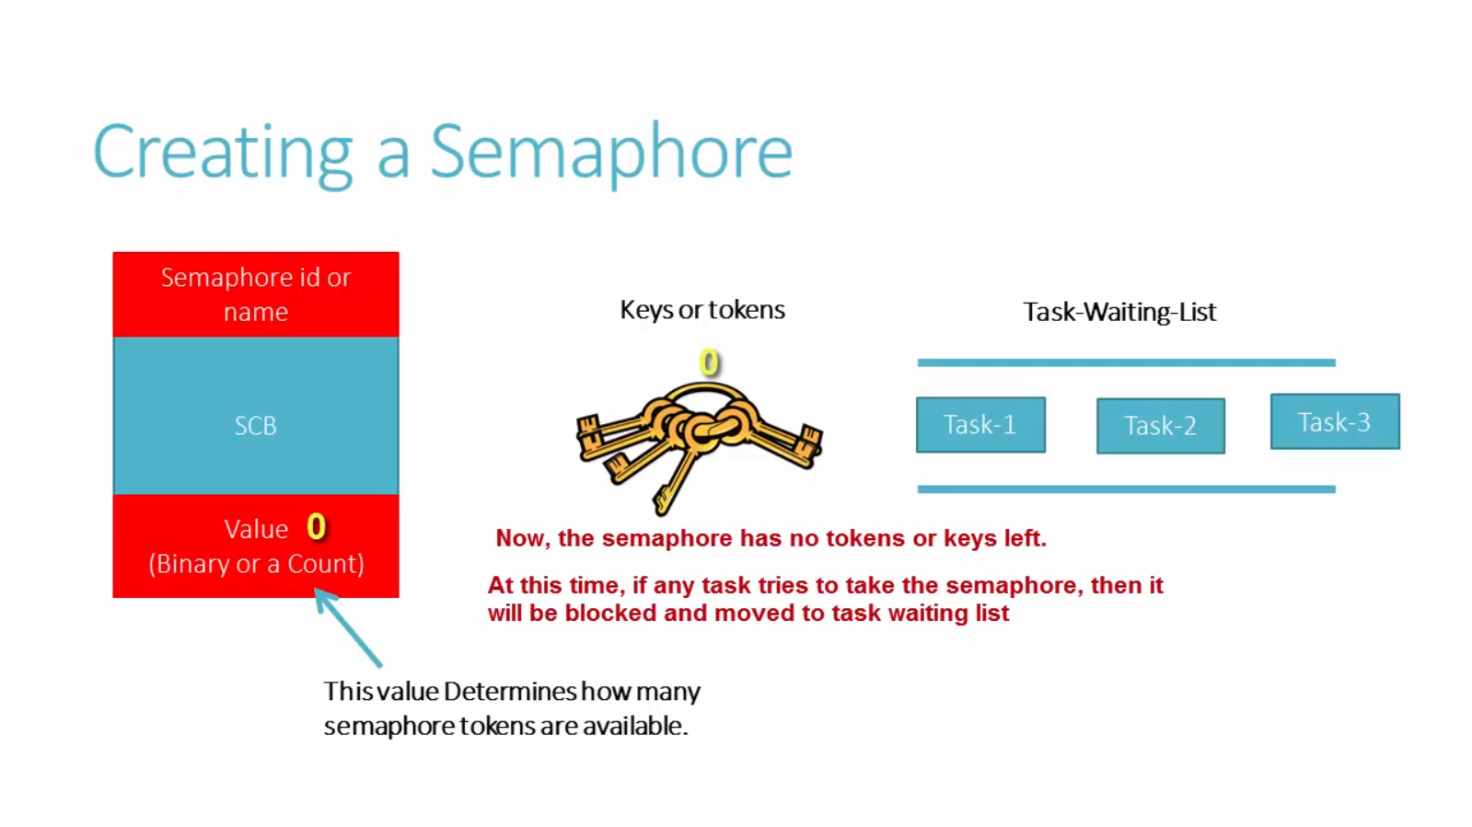

Slide 36
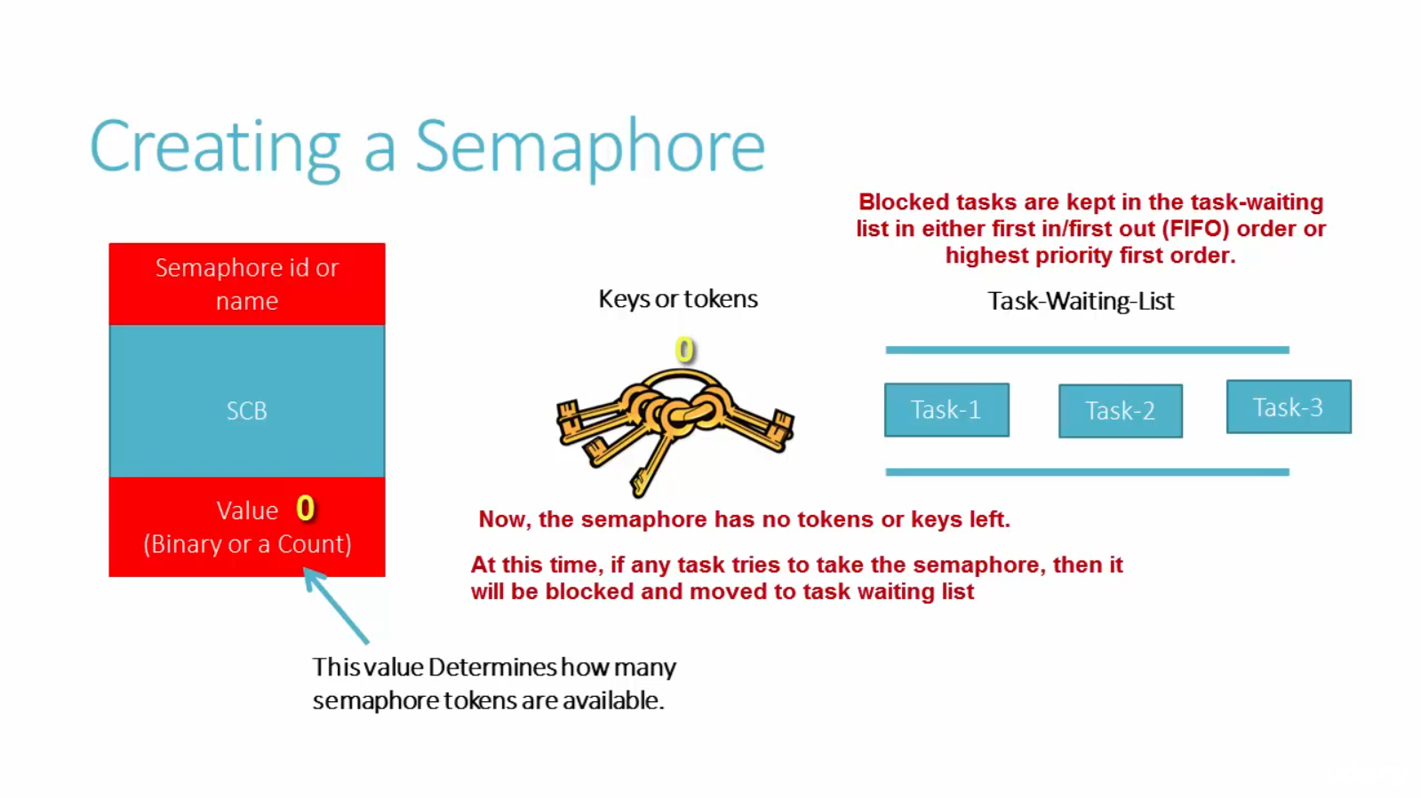

Slide 37
Two Types of Semaphore
Binary
Counting

Slide 38
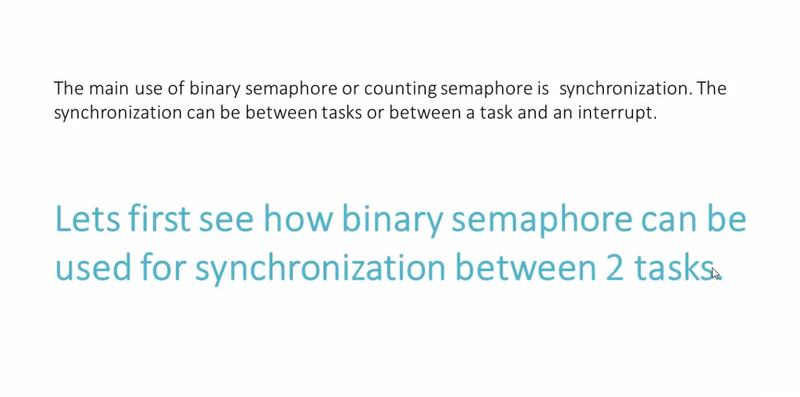

Slide 39
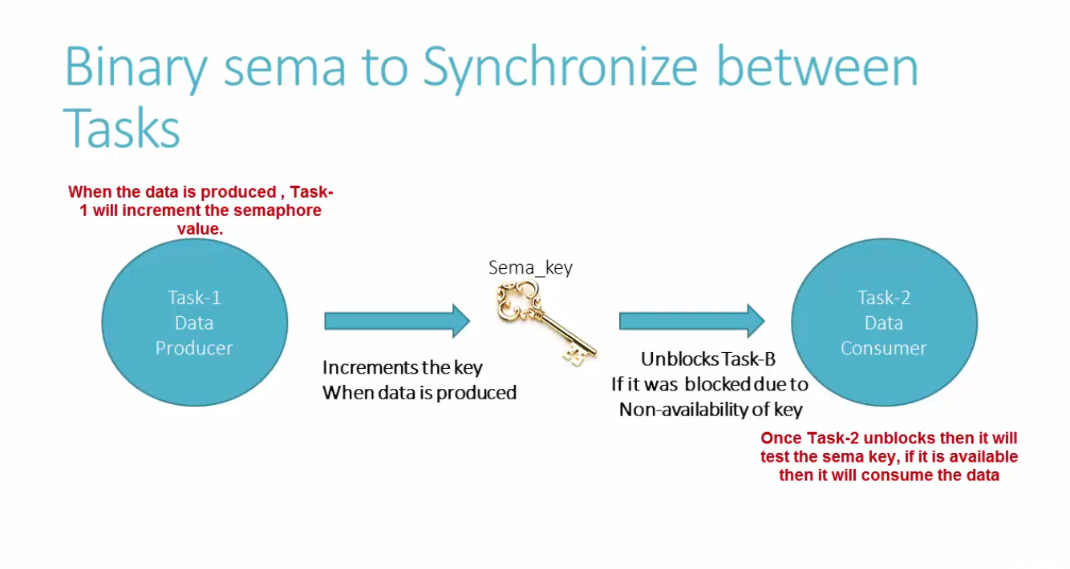

Slide 40
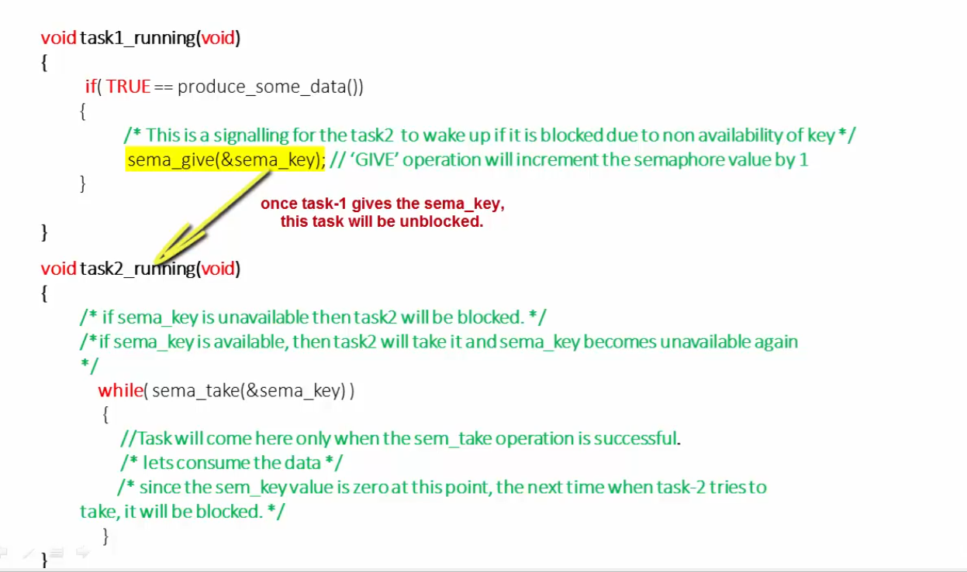

Slide 41
Implementation
Button Press
Long Press, Short Press, Toggle
Estimate time between press and release for user btn on stmxxx.
Interrupt occurs whenever pressing the user btn.
Interrupt handler give sema key and call helper_task().
Calculate relative (or) absolute time in the helper_task() and print it out SWD Console.

Slide 42
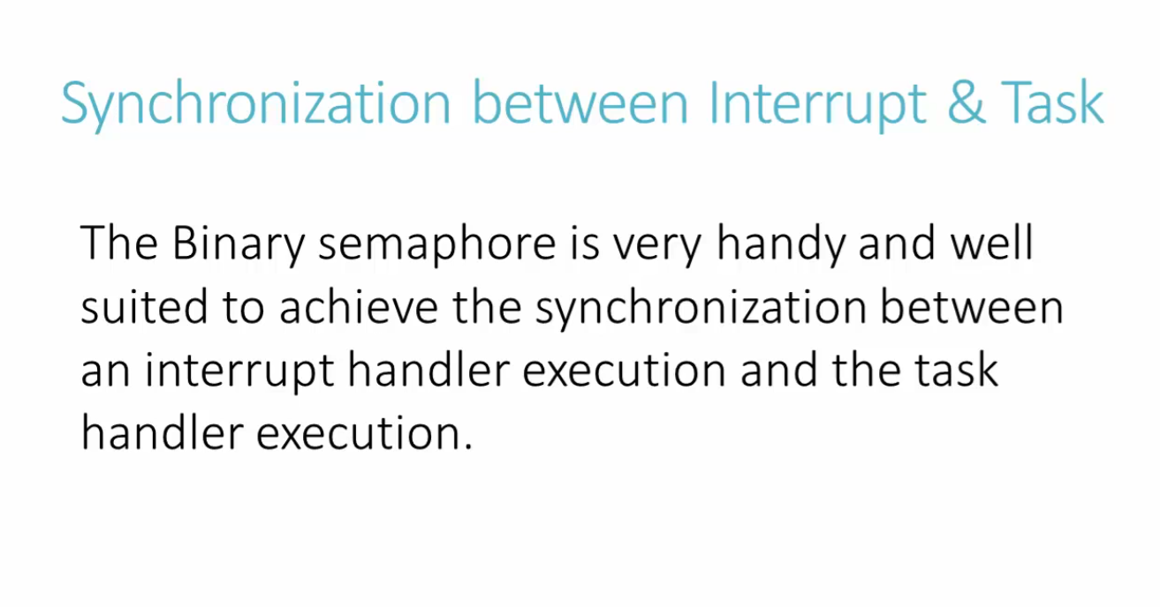

Slide 43
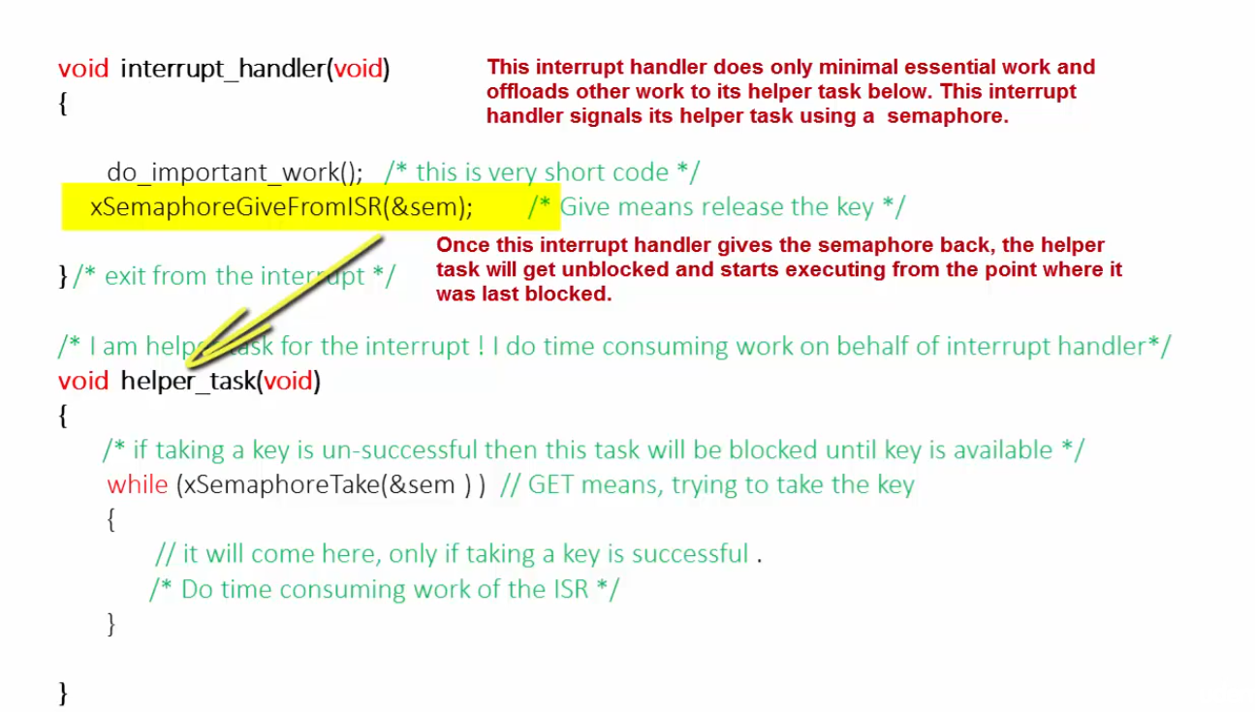

Slide 44
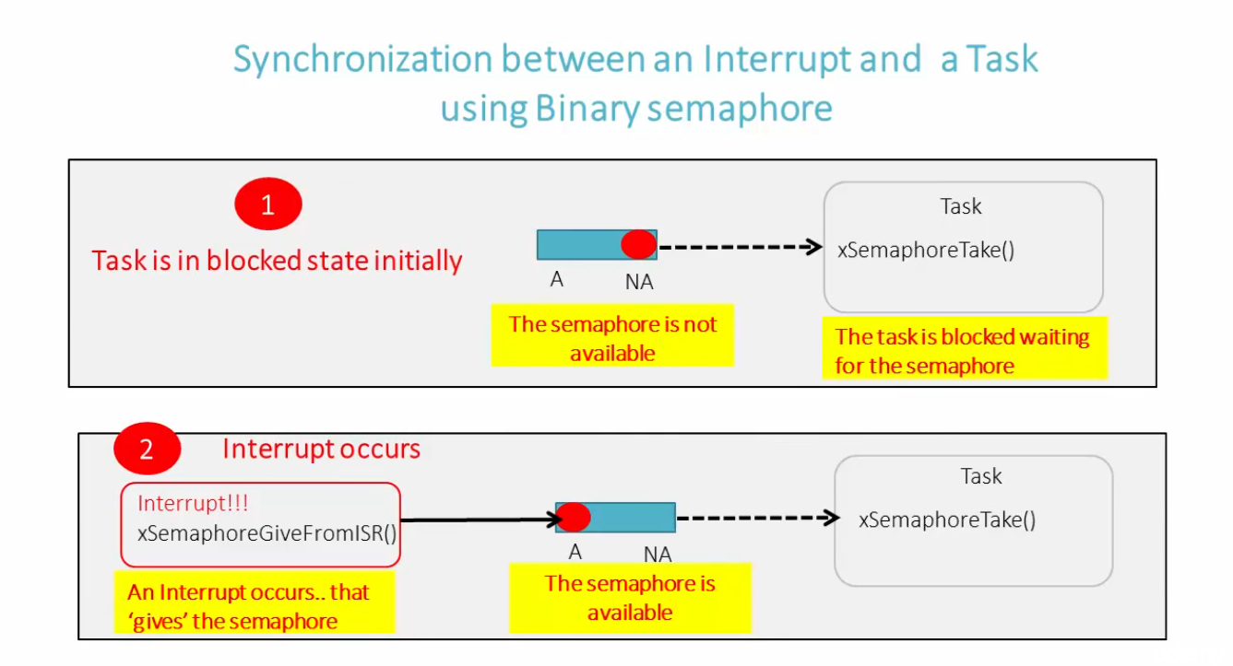

Slide 45
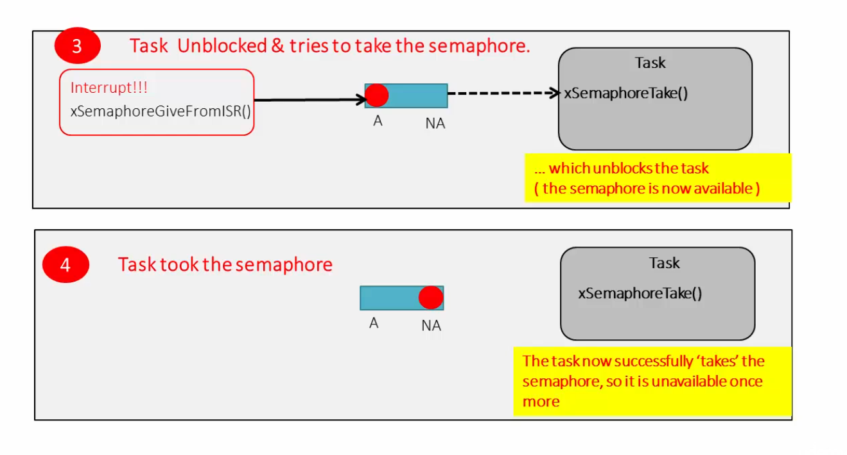

Slide 46
Interrupt Priority နဲ့ Task Priority ခွဲကြစို့။
- Higher-priority tasks preempt lower-priority tasks:
If a higher-priority task becomes ready, the currently running lower-priority task is suspended, and the higher-priority task is executed.
Round-robin scheduling: If two or more tasks have the same priority, the system can execute them in a round-robin fashion, where each task gets a time slice.
Idle task: There is always an idle task with the lowest priority that runs when no other tasks are ready.

Slide 47
NVIC Priorities (Nested Vectored Interrupt Controller)
- Lower priority numbers represent higher priority levels
an interrupt with priority 0 is the highest, and one with priority 255 is the lowest, depending on the microcontroller’s configuration.
Nested interrupts ( high priority နဲ့ interrupt ဝင်လာရင် lower priority နဲ့ handle လုပ်နေတဲ့ handler သည် interrupt အလုပ်ခံရမည်။
NVIC supports preemption priorities and sub-priorities.
Preemption priorities define which interrupt can preempt others
sub-priorities determine the order of execution when two interrupts of the same preemption priority occur simultaneously.

Slide 48
Interrupt Priority Grouping in NVIC
Interrupts can preempt tasks
Task scheduling resumes after the interrupt service handler
If a task is critical and should not be interrupted
Priority grouping is configured using the NVIC_SetPriorityGrouping() function, which decides the balance between preemption and sub-priority bits.

Slide 49
Event Latching
အကယ်၍ interrupt က helper_task အလုပ်လုပ်နေတဲ့အချိန် interrupt ၁၀ ခုဆက်တိုက်ဝင်လာမယ်ဆိုရင် ပြဿနာတက်ပါမယ်။ high frequency interrupt တွေဝင်လာတဲ့အချိန် Binary Semaphore ကိုအသုံးပြုထားမယ်ဆိုရင် Event Latch ဖြစ်ကို ဖြစ်ပါမယ်။
ရှင်းပြချက်၊ interrupt ဝင်တဲ့အချိန်တိုင်း interrupt handler က semaphore key ကို helper_Task ကို Give လုပ်နေမှာဖြစ်တယ်၊
အာ့အချိန် ၁၀ ကြိမ်ဆက်တိုက်ဝင်တဲ့အချိန်မှာ interrupt handler က semaphore key ကို Give လုပ်နေမှာဖြစ်တယ်၊ ဒါမယ့်သုံးထားတာက Binary ဖြစ်တဲ့အတွက် ပေးစရာမရှိတော့ပါဘူး။ အာ့အတွက် interrupt တစ်ခုကိုပဲ အလုပ်လုပ်ပေးပြိးကျန်တဲ့ ၉ ခုက missed ဖြစ်မှာပါ။

Slide 50
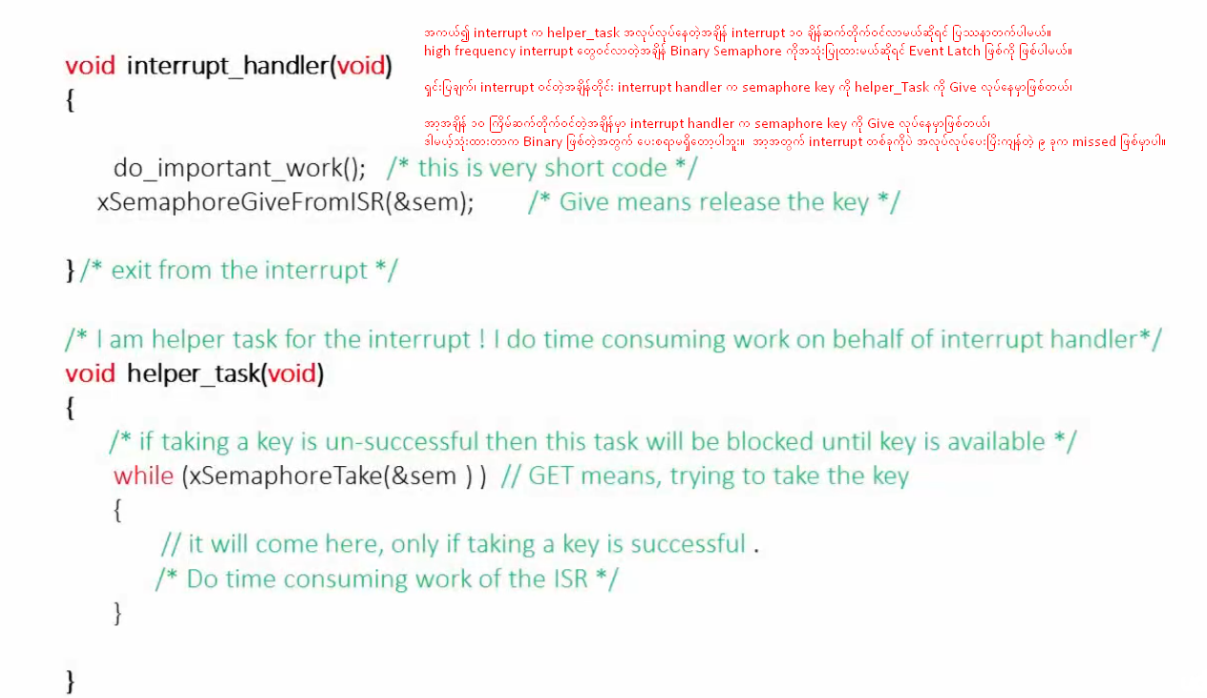
Event Latching

Slide 51
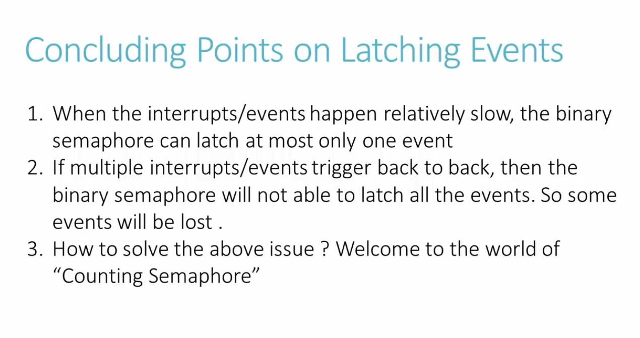

Slide 52
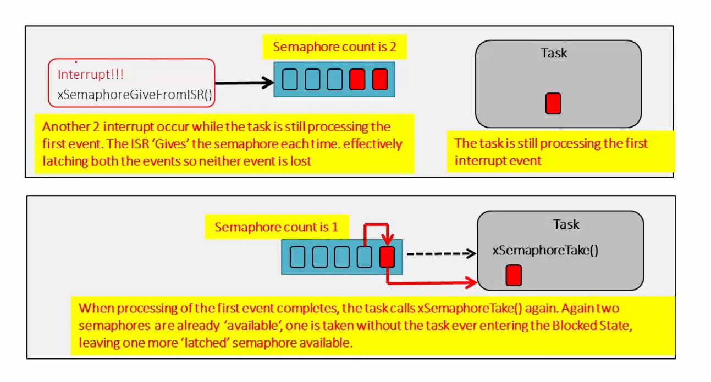

Slide 53
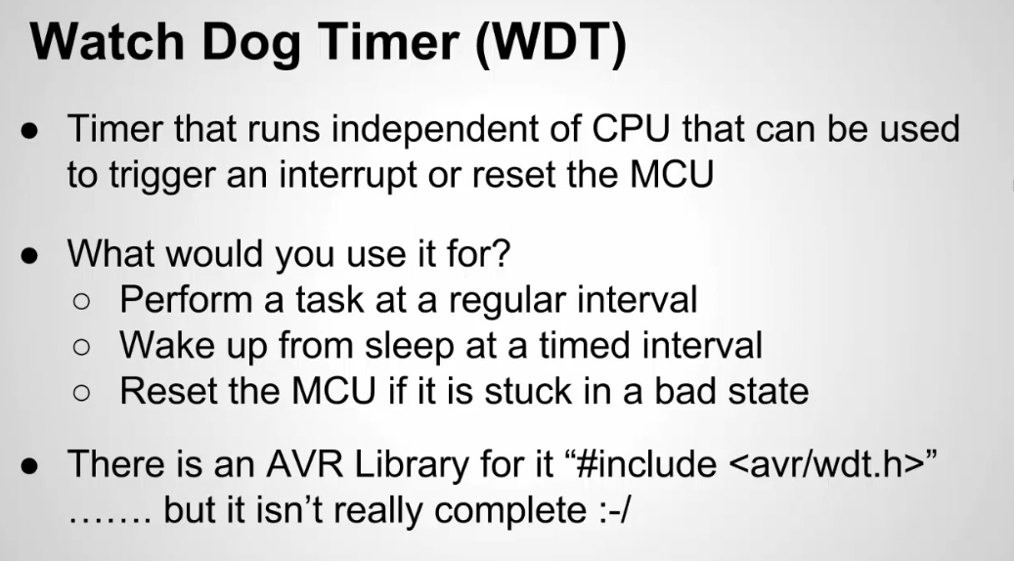

Slide 54
Operation of Watch Dog Timer (WDT)
WDT is started with a timeout period.
If the system operates correctly, it refreshes the WDT regularly (often from a high-priority task or the main loop).
If the system hangs (e.g., due to an infinite loop or deadlock), the WDT is not refreshed and expires, triggering a system reset.
The Watchdog Timer is a hardware peripheral on the microcontroller. It operates independently of the RTOS and does not require any task management.
Ensures system reliability. If the system hangs (e.g., if a critical task is stuck or the CPU gets trapped in the idle thread), the WDT will reset the system to recover from the error.

Slide 55
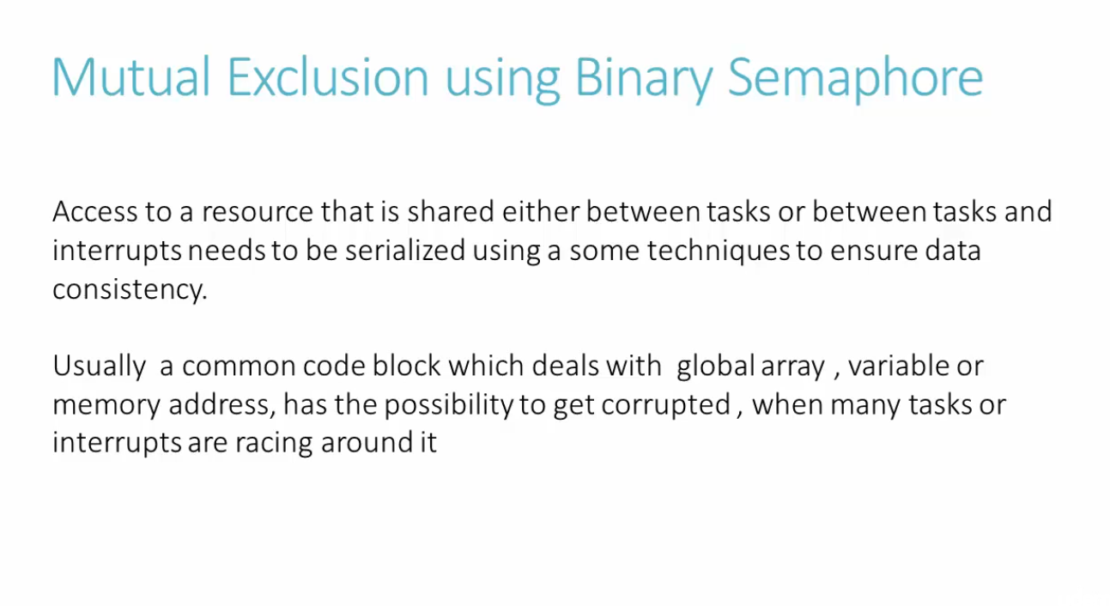

Slide 56
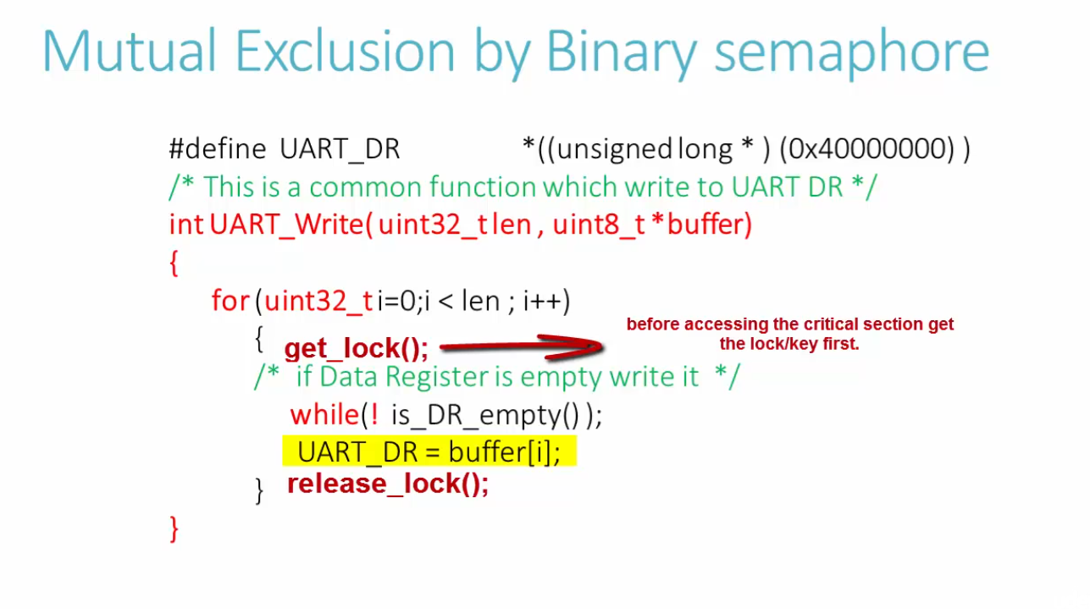

Slide 57


Slide 58


Slide 59


Slide 60
Why people say do not use binary semaphore for mutual exclusion. ??
carefully look at this timing diagram, there is a chance for priority inversion!
Task-2 which is higher priority task gets blocked due to non-availability of semaphore and it is waiting for Task-1 to release the semaphore. Right?
by this design, you made a higher priority task dependent on the lower Priority task. That is a bad.

Slide 61
Why people say do not use binary semaphore for mutual exclusion. ??
The low priority task should never decide when the higher priority task must run.
It’s like you made a king dependent on a servant to take some action.
So until lower priority task releases the semaphore, the higher priority task never runs. Isn’t it?
(Remember this is like your car and ambulance scenario i showed in the very first section of the course. You are blocking the way of ambulance. )

Slide 62
Why people say do not use binary semaphore for mutual exclusion. ??
And lower priority task will release the semaphore only when it gets allowed to run isn’t it ?
So, what if there is another medium task appears and it occupies the processor which will not allow lower Priority task to run?

Slide 63


Slide 64
ခုနပုံအရ
higher priority task is blocked and waiting for semaphore to gets released by lower priority task.
But lower priority task is not allowed to run by the medium priority task until it finishes and exits.
As a result your lower Priority task may be delayed indefinitely and the higher priority task will remain in blocked state for indefinite time . This is exactly the scenario of Priority inversion.
until medium task appears everything is OK,

Slide 65
Are there any ways to solve or reduce the priority inversion problem ?
Don’t use binary semaphore for mutual exclusion when your system has many tasks of different Priorities.
Use MUTEX instead.
MUTEX has inbuilt intelligence to minimize the priority inversion effect and this is the biggest difference between MUTEX and Binary semaphore.

Slide 66
MUTEX reduces the priority inversion effect. But how?
In RTOS systems like FreeRTOS or CMSIS-RTOS, the Mutex often implements Priority Inheritance to mitigate the priority inversion problem.
How Priority Inheritance works?

Slide 67
Priority Inheritance works
When a higher-priority task (Task H) tries to acquire a Mutex that is held by a lower-priority task (Task L), Priority Inheritance temporarily raises the priority of Task L to that of Task H.
This prevents an intermediate-priority task (Task M) from preempting Task L.
Task L continues executing at the boosted priority until it releases the Mutex. Once the Mutex is released, Task L’s priority returns to its original lower level.

Slide 68


Slide 69


Slide 70


Slide 71


Slide 72
အာ့ macro တွေဟာ Critical Session နဲ့ interrupt တွေကိုပိတ်နိုင်ဖို့ RTOS System တော်တော်များများက API ထုတ်ပေးထားတာဖြစ်တယ်။
ဒါမယ့် သုံးမယ်ဆွင်ရင် ကိုယ်သုံးတဲ့ Micro-Controller နဲ့ သေချာတိုက်ဆိုင် စစ်ဆေးပီးမှ သုံးရမှာပါ။
Architecture Dependent ဖြစ်ပါတယ်။

